Slide 1
DS-UNIT-IV
Model Evaluation and Selection,
Techniques to Improve Classification Accuracy.

Slide 2
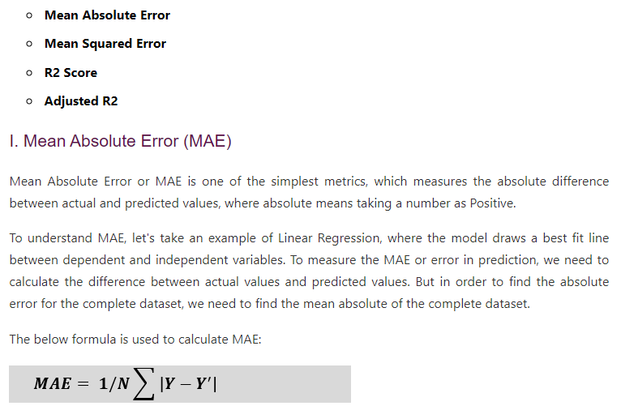
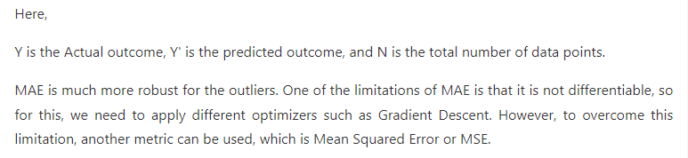
Regression performance metrics

Slide 3
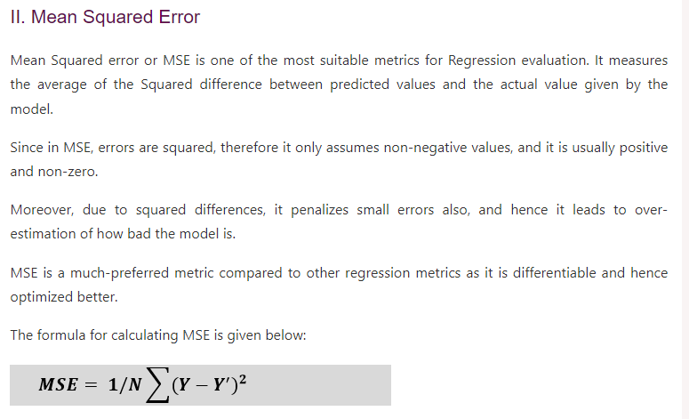

Slide 4
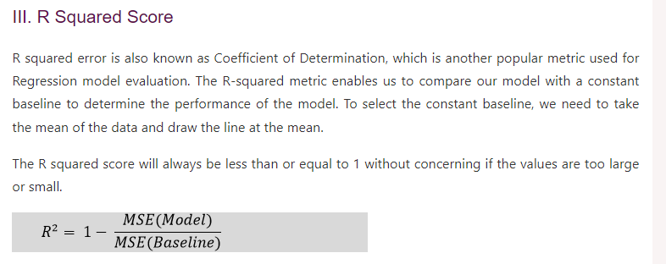

Slide 5
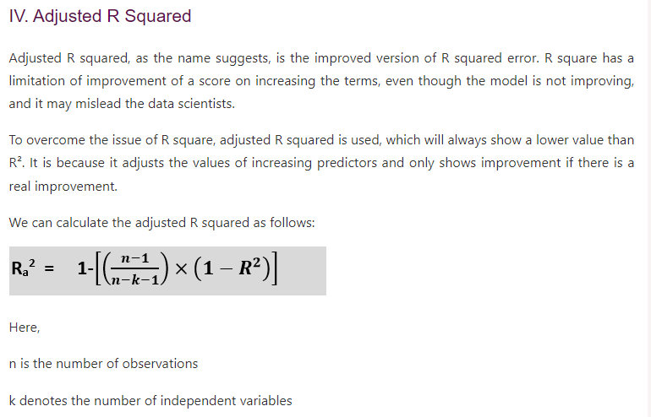

Slide 6
Model Evaluation and Selection
Evaluation metrics: How can we measure accuracy? Other metrics to consider?
Use validation test set of class-labeled tuples instead of training set when assessing accuracy
Methods for estimating a classifier’s accuracy:
Holdout method, random subsampling
Cross-validation
Bootstrap
Comparing classifiers:
Confidence intervals
Cost-benefit analysis and ROC Curves
6

Slide 7
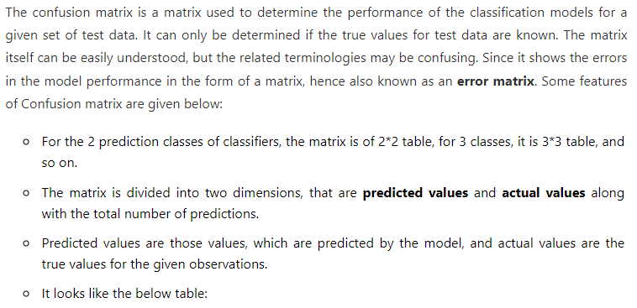
Classification Model Evaluation Metrics:

Slide 8
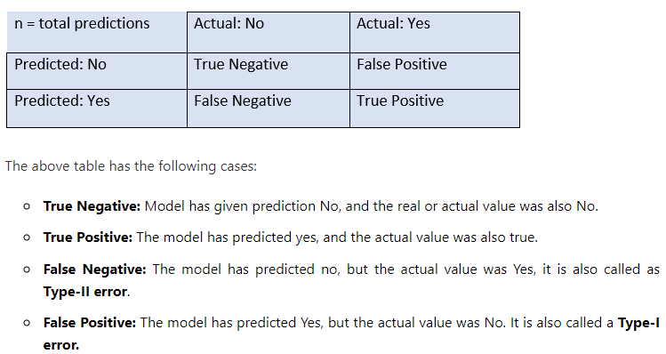
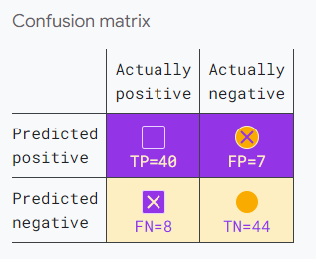

Slide 9
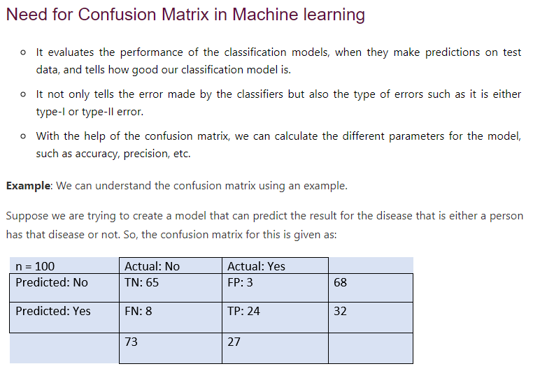

Slide 10
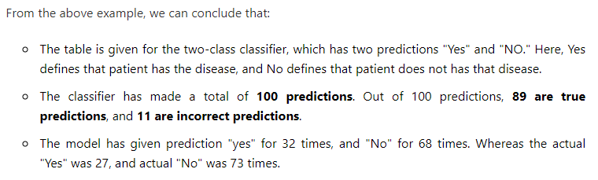

Slide 11
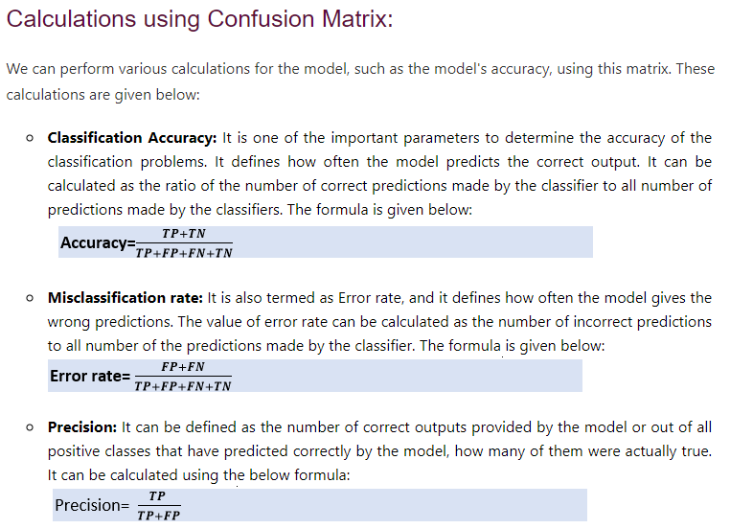

Slide 12
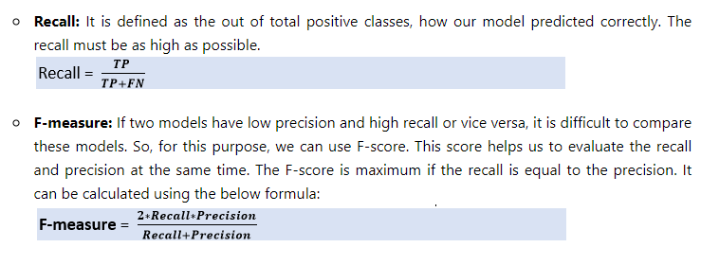
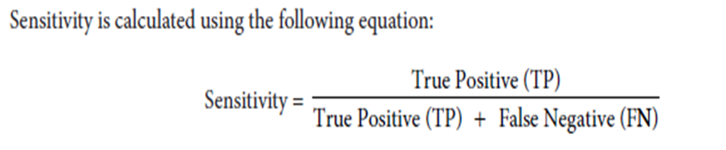
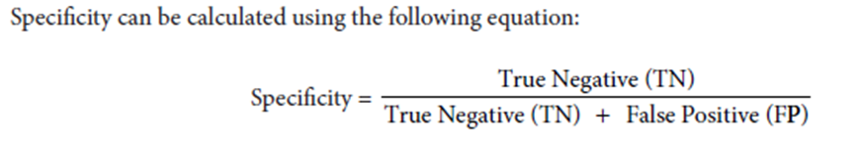

Slide 13
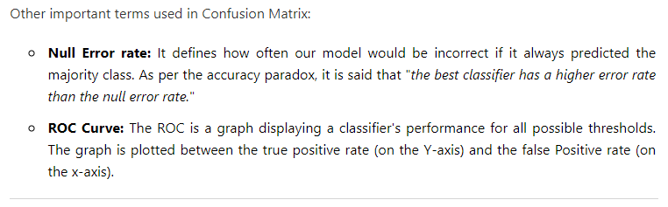

Slide 14
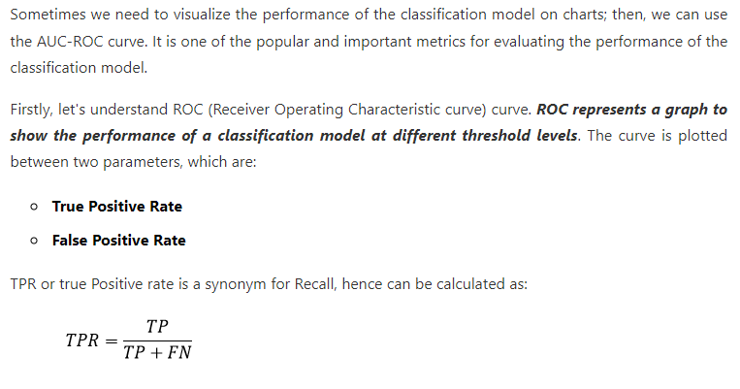
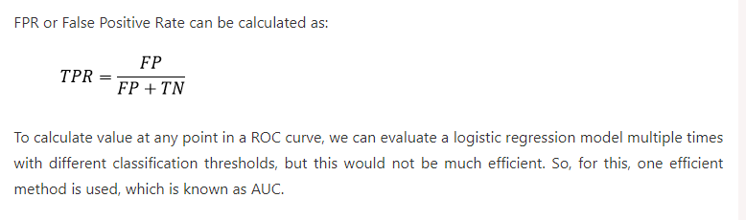
ROC Curve(Receiver Operating Characteristic curve)

Slide 15
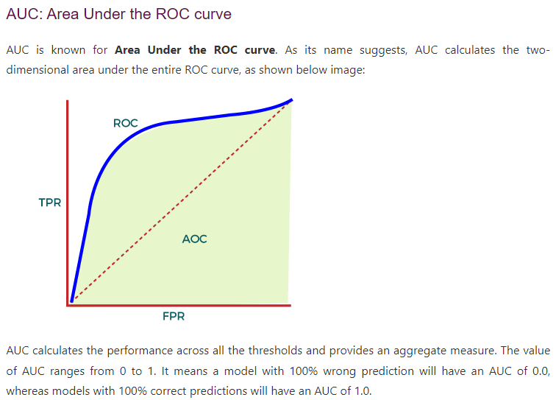
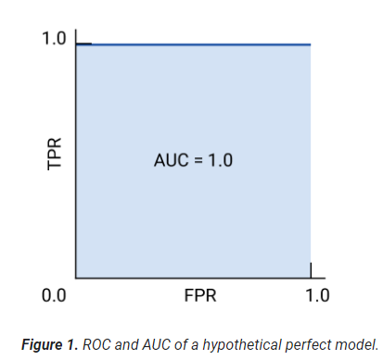
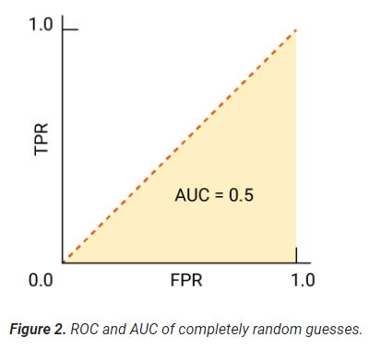

Slide 16
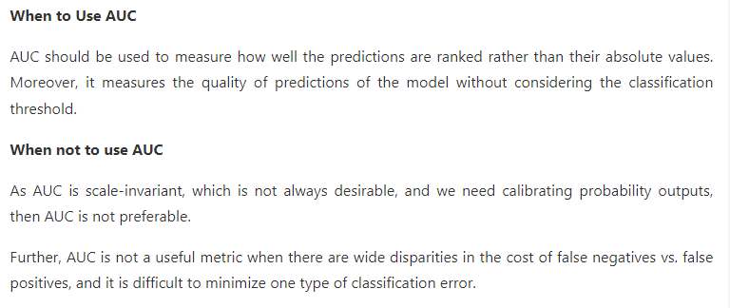

Slide 17
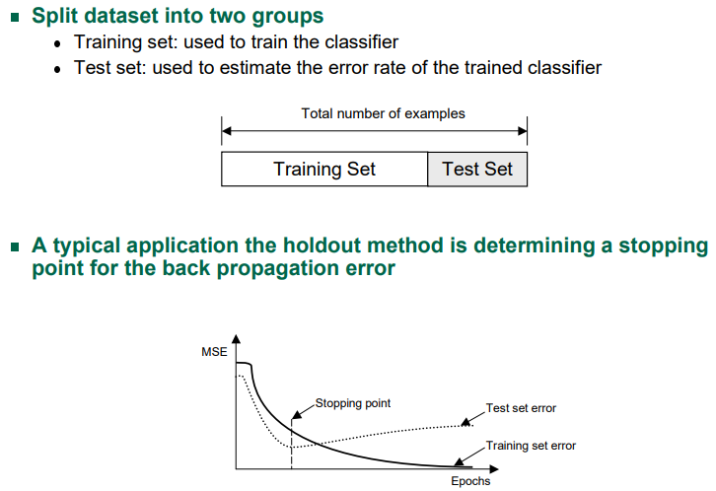
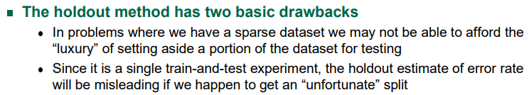
Evaluating Classifier Accuracy: Holdout & Cross-Validation Methods
Holdout method
Given data is randomly partitioned into two independent sets
Training set (e.g., 2/3) for model construction
Test set (e.g., 1/3) for accuracy estimation
17

Slide 18
Evaluating Classifier Accuracy: Holdout & Cross-Validation Methods
The limitations of the holdout can be overcome with a family of resampling methods at the expense of more computations n Cross Validation
Random Subsampling
K-Fold Cross-Validation
Leave-one-out Cross-Validation
Bootstrap
18

Slide 19
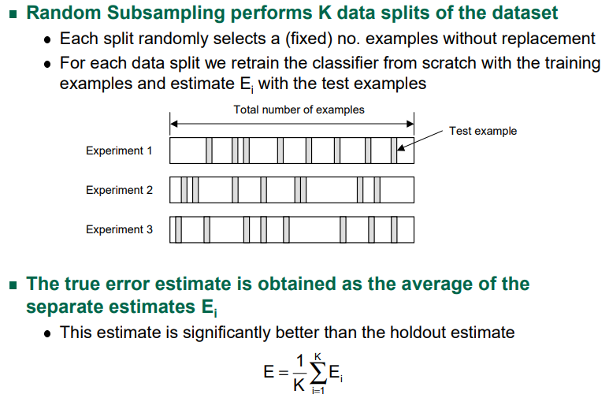

Slide 20
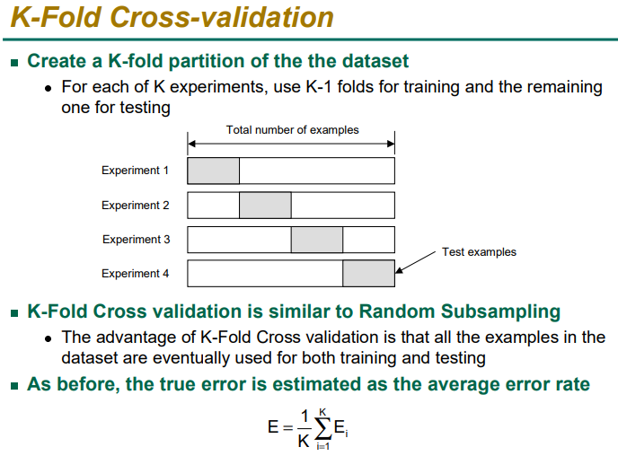

Slide 21
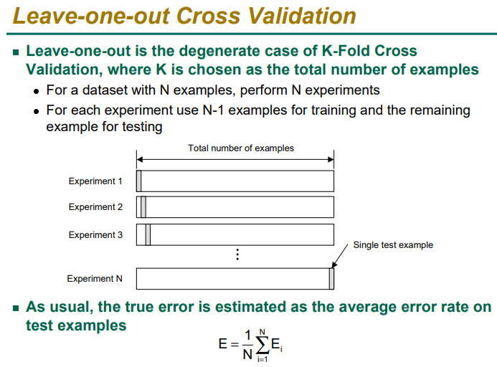

Slide 22
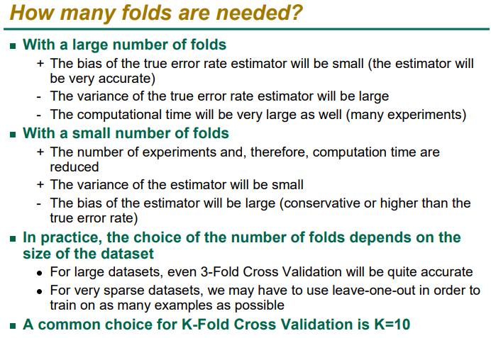

Slide 23
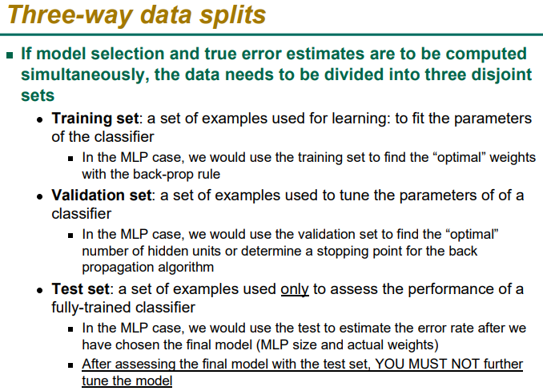

Slide 24
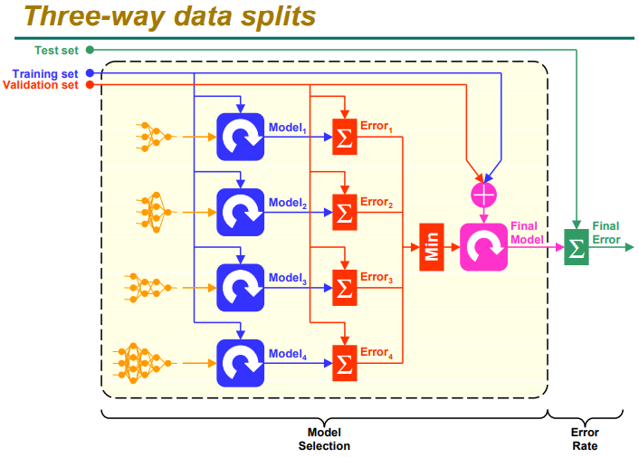

Slide 25

Evaluating Classifier Accuracy: Bootstrap
Bootstrap
Works well with small data sets
Samples the given training tuples uniformly with replacement
i.e., each time a tuple is selected, it is equally likely to be selected again and re-added to the training set
Several bootstrap methods, and a common one is .632 boostrap
A data set with d tuples is sampled d times, with replacement, resulting in a training set of d samples. The data tuples that did not make it into the training set end up forming the test set. About 63.2% of the original data end up in the bootstrap, and the remaining 36.8% form the test set (since (1 – 1/d)^{d} ≈ e⁻¹ = 0.368)
Repeat the sampling procedure k times, overall accuracy of the model:
25

Slide 26


Estimating Confidence Intervals: Classifier Models M₁ vs. M₂
Suppose we have 2 classifiers, M₁ and M₂, which one is better?
Use 10-fold cross-validation to obtain and
These mean error rates are just estimates of error on the true population of future data cases
What if the difference between the 2 error rates is just attributed to chance?
Use a test of statistical significance
Obtain confidence limits for our error estimates
26

Slide 27
Estimating Confidence Intervals: Null Hypothesis
Perform 10-fold cross-validation
Assume samples follow a t distribution with k–1 degrees of freedom (here, k=10)
Use t-test (or Student’s t-test)
Null Hypothesis: M₁ & M₂ are the same
If we can reject null hypothesis, then
we conclude that the difference between M₁ & M₂ is statistically significant
Chose model with lower error rate
27

Slide 28
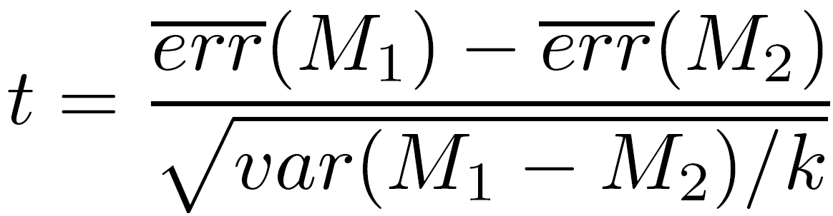
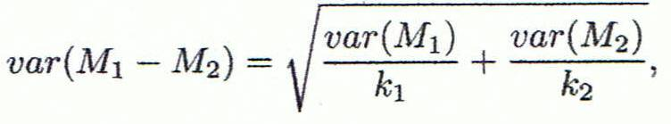
Estimating Confidence Intervals: t-test
If only 1 test set available: pairwise comparison
For i^{th} round of 10-fold cross-validation, the same cross partitioning is used to obtain err(M₁)_{i} and err(M₂)_{i}
Average over 10 rounds to get
t-test computes t-statistic with k-1 degrees of freedom:
If two test sets available: use non-paired t-test
and
where
where
where k₁ & k₂ are # of cross-validation samples used for M₁ & M₂, resp.
28

Slide 29
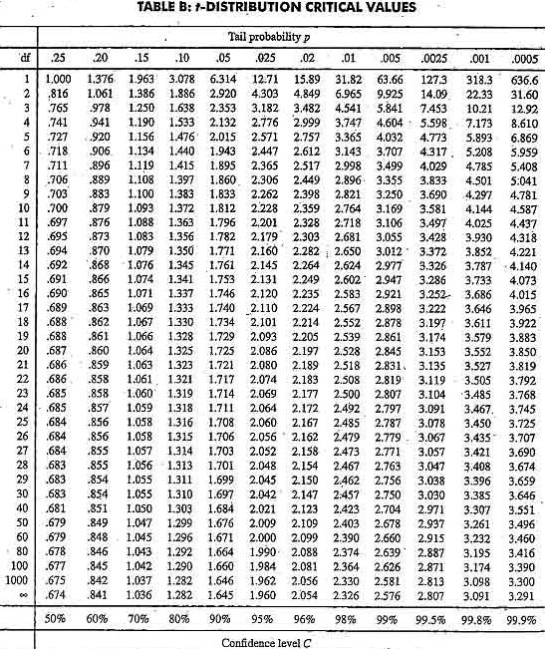
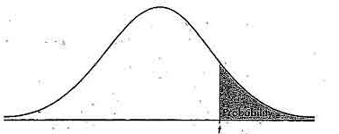
Estimating Confidence Intervals: Table for t-distribution
Symmetric
Significance level, e.g., sig = 0.05 or 5% means M₁ & M₂ are significantly different for 95% of population
Confidence limit, z = sig/2
29

Slide 30
Estimating Confidence Intervals: Statistical Significance
Are M₁ & M₂ significantly different?
Compute t. Select significance level (e.g. sig = 5%)
Consult table for t-distribution: Find t value corresponding to k-1 degrees of freedom (here, 9)
t-distribution is symmetric: typically upper % points of distribution shown → look up value for confidence limit z=sig/2 (here, 0.025)
If t > z or t < -z, then t value lies in rejection region:
Reject null hypothesis that mean error rates of M₁ & M₂ are same
Conclude: statistically significant difference between M₁ & M₂
Otherwise, conclude that any difference is chance
30

Slide 31
Model Selection: ROC Curves
ROC (Receiver Operating Characteristics) curves: for visual comparison of classification models
Originated from signal detection theory
Shows the trade-off between the true positive rate and the false positive rate
The area under the ROC curve is a measure of the accuracy of the model
Rank the test tuples in decreasing order: the one that is most likely to belong to the positive class appears at the top of the list
The closer to the diagonal line (i.e., the closer the area is to 0.5), the less accurate is the model
Vertical axis represents the true positive rate
Horizontal axis rep. the false positive rate
The plot also shows a diagonal line
A model with perfect accuracy will have an area of 1.0
31

Slide 32
Issues Affecting Model Selection
Accuracy
classifier accuracy: predicting class label
Speed
time to construct the model (training time)
time to use the model (classification/prediction time)
Robustness: handling noise and missing values
Scalability: efficiency in disk-resident databases
Interpretability
understanding and insight provided by the model
Other measures, e.g., goodness of rules, such as decision tree size or compactness of classification rules
32
Notes:
32

Slide 33
Techniques to Improve Classification Accuracy

Slide 34
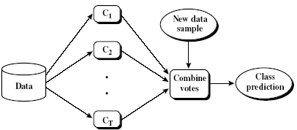
Ensemble Methods: Increasing the Accuracy
Ensemble methods
Use a combination of models to increase accuracy
Combine a series of k learned models, M₁, M₂, …, M_{k}, with the aim of creating an improved model M*
Popular ensemble methods
Bagging: averaging the prediction over a collection of classifiers
Boosting: weighted vote with a collection of classifiers
Ensemble: combining a set of heterogeneous classifiers
34

Slide 35
Ensemble Algorithms
These algorithms combines the decisions from multiple models to improve the overall performance.
This approach allows the production of better predictive performance compared to a single model.
Advantage : Improvement in predictive accuracy. Disadvantage : It is difficult to understand an ensemble of classifiers.
Basic Ensemble Techniques Max Voting, Averaging, Weighted Average
2. Advanced Ensemble Techniques Stacking, Blending, Bagging, Boosting
3. Algorithms based on Bagging and Boosting Bagging : Bagging meta-estimator Random Forest Boosting: AdaBoost ,GBM, XGB, Light GBM, CatBoost

Slide 36
Why do ensembles work?
It address the following problems
Statistical Problem The Computational Problem arises when the learning algorithm cannot guarantees finding the best hypothesis.
Representational Problem The Representational Problem arises when the hypothesis space does not contain any good approximation of the target class(es).

Slide 37
Types of ensemble method
There are many ensemble techniques available, but we will discuss about the below two most widely used methods:
1. Bagging
2. Boosting
Let us first understand the similarities and differences between both terminologies.
Both the methods can be used for classification (discrete output) and regression (continuous output) problems.
­Both methods are better in performance compared to single models as they aggregate the output of all the weak learners via voting thereby leading to more accuracy in the predictions.

Slide 38
Bagging( Bootstrap Aggregation)
Bagging (Bootstrap Aggregation) is used to reduce the variance of a decision tree. Suppose a set D of d tuples, at each iteration i, a training set D_{i} of d tuples is sampled with replacement from D (i.e., bootstrap).
Then a classifier model M_{i} is learned for each training set D < i.
Each classifier M_{i} returns its class prediction.
The bagged classifier M* counts the votes and assigns the class with the most votes to X (unknown sample).

Slide 39
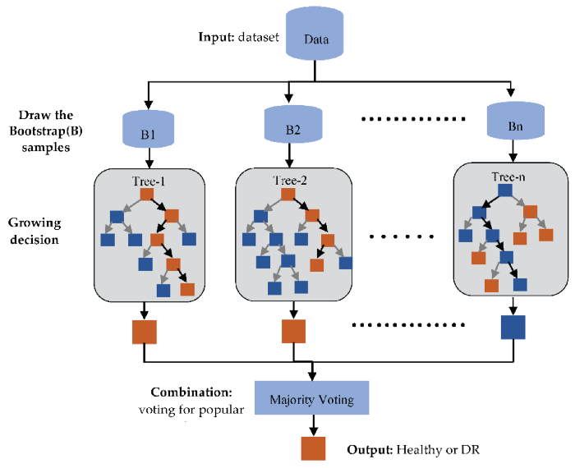
Implementation steps of Bagging(Bootstrap)
Multiple subsets are created from the original data set with equal tuples, selecting observations with replacement.(Row sampling replacement)
A base model is created on each of these subsets.
Each model is learned in parallel from each training set and independent of each other.
The final predictions are determined by combining the predictions from all the models. Classify by majority voting

Slide 40
Boosting
The idea of Boosting method is that instead of using a simple algorithm, which is not strong enough to make the accurate predictions alone as there are high variance and error rate, we combine multiple simple learning algorithms together, rather than finding a single highly accurate prediction rule.
The Boosting algorithm then combines these multiple weak rules together to reduce variance and bias in individual model rules into a single prediction rule, such that it will be much more accurate than any one of the weak rules as.

Slide 41
Boosting
Two fundamental approaches for effective implementation of Boosting algorithm:
Choosing the different subsets from training dataset for different iterations:
To increase the efficiency of the base learner predictions, high weightage is placed on the examples that were misclassified by earlier weak learner.
How to combine weak leaners together:
Taking a weighted majority vote of the predictions.

Slide 42
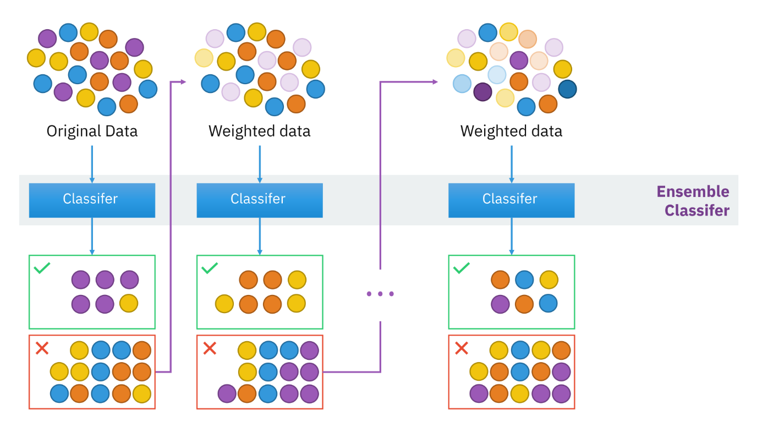
Boosting

Slide 43
Boosting Algorithm
Step 1: All observations have equal weight in the original training data set D₁. An initial “base” classifier h₁ is determined.
Step 2: The observations that were incorrectly classified by the previous base classifier have their weights increased, while the observations that were correctly classified have their weights decreased.
This gives us data distribution D_{m}, m=2, … , M.
A new base classifier hm, m = 2, … , M is determined, based on the new weights. This step is repeated until the desired number of iterations M is achieved.
Step 3: The final boosted classifier is the weighted sum of the M base classifiers

Slide 44
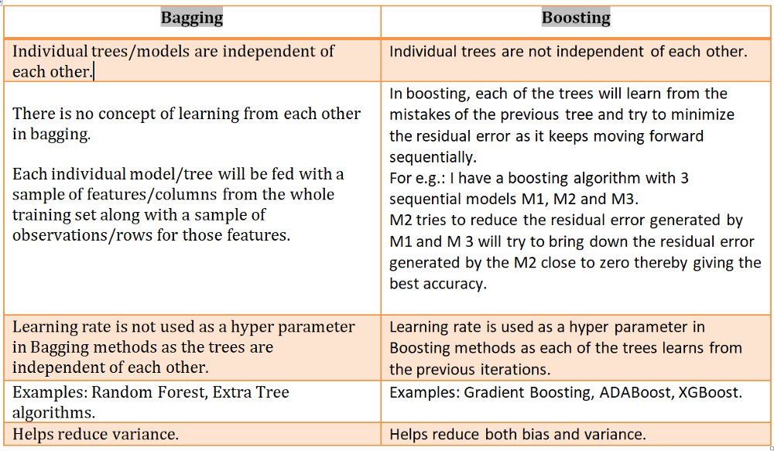
Differences Bagging and Boosting

Slide 45
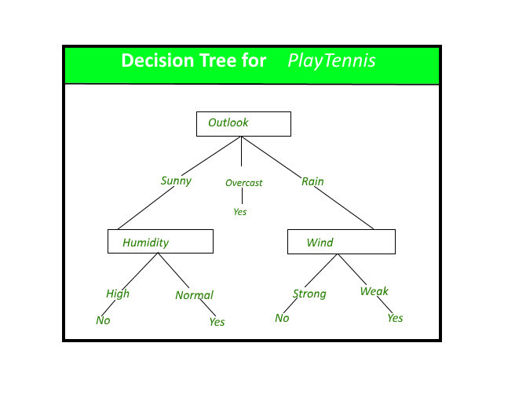
Decision tree: Its issues
Decision tree is the most powerful and popular tool for classification and prediction.
A Decision tree is a flowchart like tree structure, where each internal node denotes a test on an attribute, each branch represents an outcome of the test, and each leaf node (terminal node) holds a class label.
Issues:
Overfitting the data: High variance, low bias
Guarding against bad attribute choices
Handling continuous valued attributes
Handling missing attribute values
Handling attributes with differing costs

Slide 46
Random forest
Random reduce high variance in Decision tree.
A Random forest is an ensemble learning method where multiple decision trees are constructed , trained by Bagging method and then they are merged to get a more accurate prediction.
Random forest is a supervised learning algorithm which is used for both classification as well as regression.
Forest is made up of trees and more trees means more robust forest.
Random forest algorithm creates decision trees on data samples and then gets the prediction from each of them and finally selects the best solution by means of voting.
It is an ensemble method which is better than a single decision tree because it reduces the over-fitting by averaging the result.

Slide 47
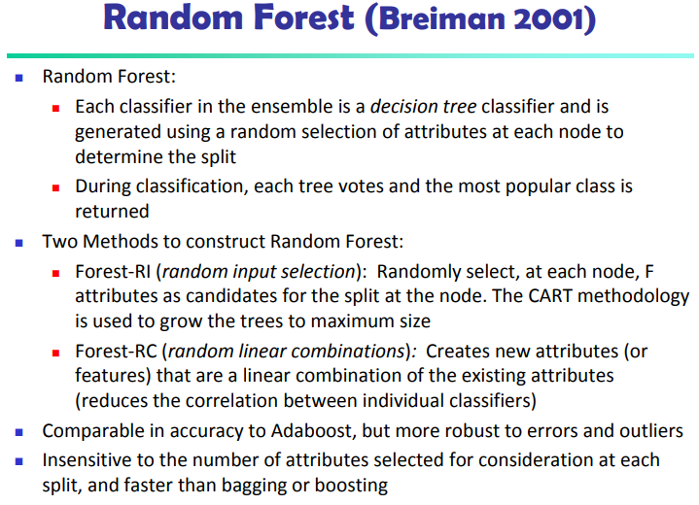

Slide 48
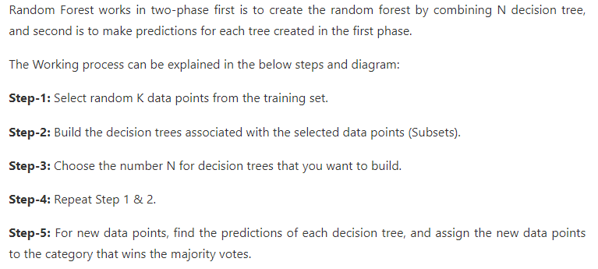
Random Forest

Slide 49
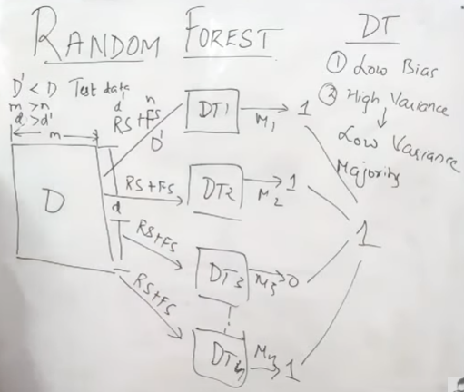
Random forest

Slide 50
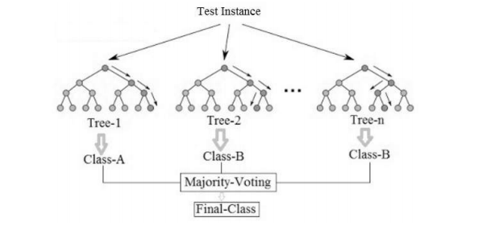
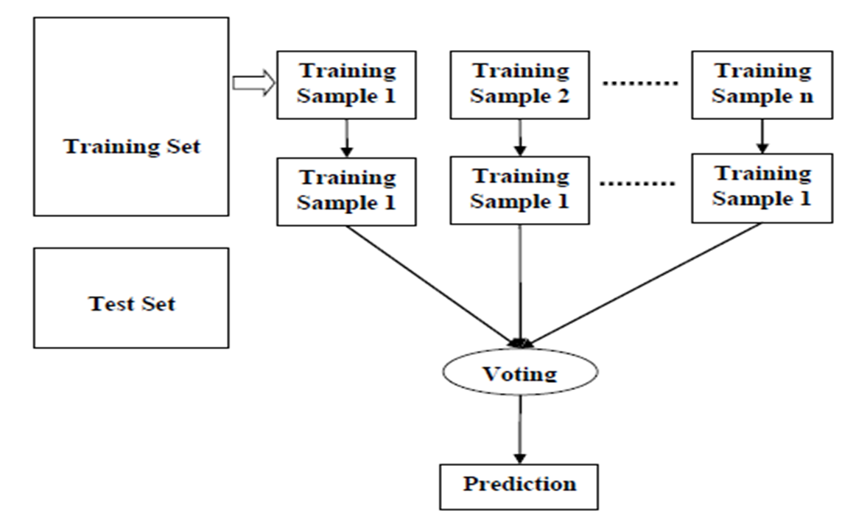
Example of random forest with majority voting

Slide 51
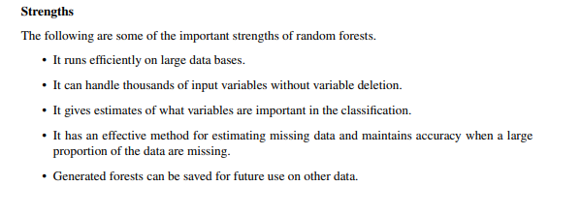
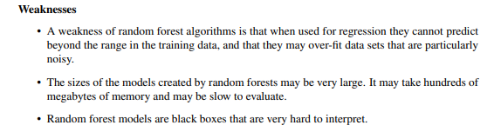
Strengths and weakness

Slide 52
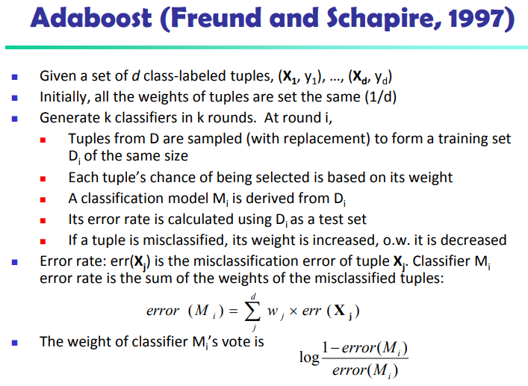

Slide 53
Classification of Class-Imbalanced Data Sets
Class-imbalance problem: Rare positive example but numerous negative ones, e.g., medical diagnosis, fraud, oil-spill, fault, etc.
Traditional methods assume a balanced distribution of classes and equal error costs: not suitable for class-imbalanced data
Typical methods for imbalance data in 2-class classification:
Oversampling: re-sampling of data from positive class
Under-sampling: randomly eliminate tuples from negative class
Threshold-moving: moves the decision threshold, t, so that the rare class tuples are easier to classify, and hence, less chance of costly false negative errors
Ensemble techniques: Ensemble multiple classifiers introduced above
Still difficult for class imbalance problem on multiclass tasks
53

Slide 54
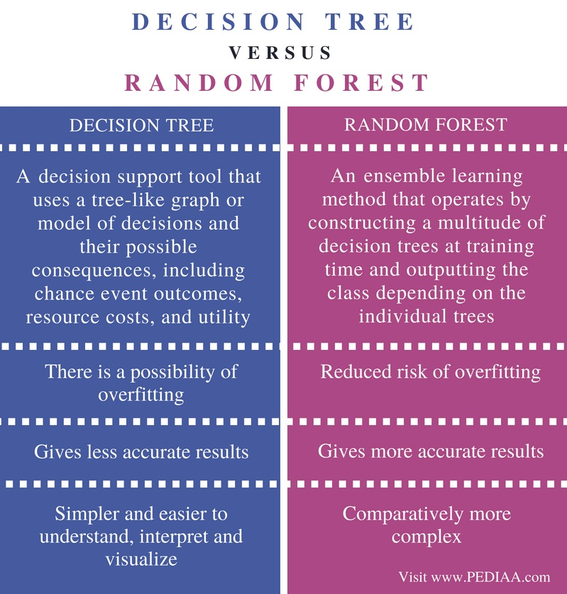
Difference between Decision tree, Random forest

Slide 55
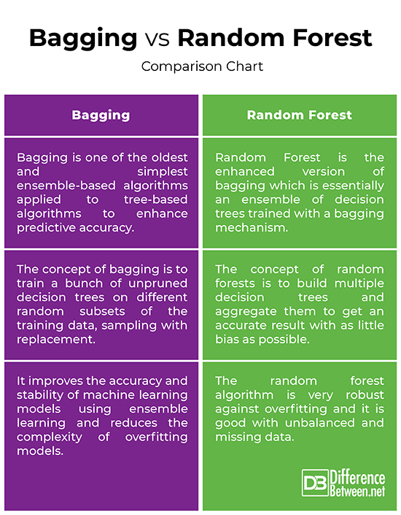
Difference between Bagging vs Random forest

